Slide 1
Picking the ripe cherry: Extract selection in qualitative research
Stephen Louw, Richard Watson Todd & Pattamawan Jimarkon
Notes:
Greeting, welcome, introduction, topic.

Slide 2
Observed teaching in pre-service training courses in TESOL
Notes:
Background to my data. Observed teaching in a pre-service, and the feedback afterwards.

Slide 3
Feedback for evaluation
Feedback for development
Notes:
Two perspectives on feedback:
1. feedback is a learning opportunity, trainer identify areas of weakness and address. 2. feedback as coconstruction with the trainer, characterized by reflective approach

Slide 4
Dialogicity
Single authoring
Evaluative voice
Single truth
Control over talk
Joint co-construction
Elaborative voice
Tolerance of multiple perspectives
Shared control
High Authoritative
High Dialogic
Notes:
Visualise this difference using Bakhtinian dialogicity: dialogicity and authoritative.
Authoritative is expected. Dialogicity may be considered more beneficial. Which do the trainers use?

Slide 5
Single authoring
Control
391 | T | No it also depends on how comfortable the students are with you and more importantly with each other
392 | P | Yeah mm
393 | T | Alright um I would have said also try to make it a little more open don’t give them the language don’t give them the script
394 | P | Yeah
395 | T | Read this script rather just give them the prompt and let them apply it in their own ways and as like and that is more likely to happen then “so you have a baby this week ah yeah well I might er”
396 | P | Yeah
397 | T | you know and you actually end up saying things like “well I might” er and I and you said “er no I won’t” and I said “are you sure?” and you said “well okay well I might not” you know and that’s
398 | P | Yeah
399 | T | don’t script it
Evaluation
Single truth
Notes:
We can see this is highly authoritative feedback. It is single authored, high control over the topic, evaluative but only from the trainer, who imposes a single truth.

Slide 6
Feedback following teaching practice in pre-service teacher training is authoritative
Notes:
We might conclude then that FTP is authoritative in its nature.

Slide 7
Shared control
Elaborative voice
406 | C | Because because that I mean that that all comes that’s that was a very special moment for me er
407 | T | So it was
408 | C | it was try trying to get the word special or trying to get the word journey out of an American was
409 | T | (cough) But the the reason why it worked here is because you built up to that
410 | C | Mm
411 | T | if you had have gone straight. the first word you tried to get astrology I don’t think you would have got it
412 | C | Mm
413 | T | but because of this concept of space
414 | C | Mm
415 | T | Was already here it was easy
416 | C | But also I mean as- astrology the the the the
417 | T | And the key questions you asked
418 | C | Yeah the break up of the the word astrology it’s made up of two words
Multiple perspectives
Joint co-construction
Notes:
Or is it? Here is an example of feedback that is highly dialogic.
Notice the shared control over topics, the elaborative voice, joint construction, overlapping turns, shared turns

Slide 8
Feedback following teaching practice in pre-service teacher training is dialogic
Notes:
Might we say that feedback on TP is dialogic?
Obviously you could tell that both of these come from the same data set.

Slide 9
Cherry picking
Selecting data to confirm a particular position
Providing incomplete evidence
Notes:
By cherry picking from my data I can demonstrate either position, even though they are opposing findings.
What is cherry picking?

Slide 10
Avoid cherry picking
Base the findings on the entire set
But!
Presenting findings from qualitative studies?
Large amounts of data
Publication needs a ‘sample’ of the data
Notes:
Obviously nobody wants to be seen as cherry picking.
But what about the problem of selecting data for presentation.
Especially with qualitative data that is large and therefore a small sample can be presented in a publication?

Slide 11
A principled approach to data selection
Goals:
Find a ‘typical’ stretch of data for selection
Based on the entire data set
Be rigorous
Notes:
We have to find a way to select data in a principled way that doesn’t open the research to the threat of cherry picking.

Slide 12
A “typical” stretch
Notes:
What does typical mean?
- typifies this data, distinguishes it from other data, shows the essence of the data. Example, I have 4 trainers - what is the essence of this one?

Slide 13
Keyword
A word which appears in a text statistically significantly more frequently than would be expected by chance
Baker, Hardie and McEnery (2006: 97)
Notes:
To go about it we are going to use a corpus approach. Corpus uses the whole data set, and using lexical frequencies gives insights into the data that may not be otherwise observable.

Slide 14
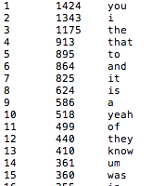
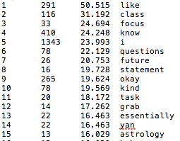
Word list
Keyword list
Notes:
This is the difference between a word list and a key word list. On the left is rank, frequency and the word. This is just a list of the words and their frequencies in the corpus. The keyword list is the list of words which occur in the corpus at a greater frequency than would be expected by chance when compared with another corpus.

Slide 15
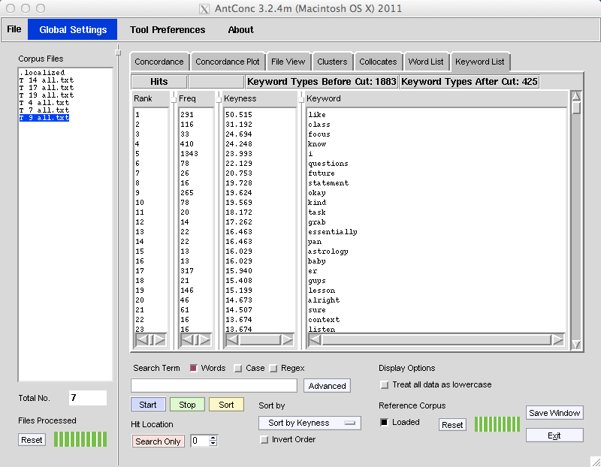
Corpus tools: keywords
Notes:
We start with the corpus.
The advantages of corpus: entire data set, a representation of the data based on lexical frequencies, objective
Then get keywords. A keyword is…

Slide 16
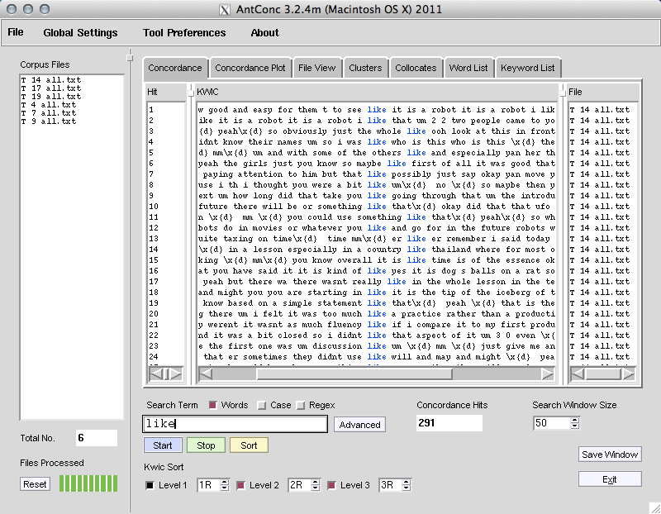
Concordance

Slide 17
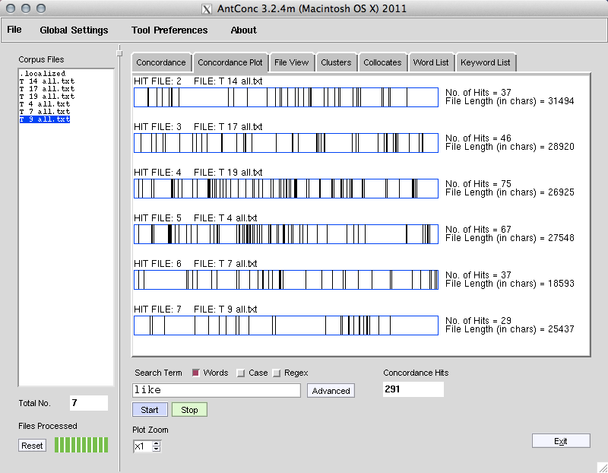
Concordance plot tool
Notes:
The concordance plot tool indicates where these keywords fall in the file

Slide 18
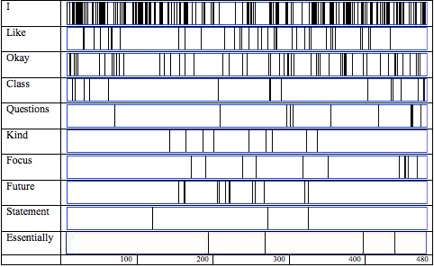
Plots summary
Notes:
Collect all the data plots together and make a diagram of the file with the location of each keyword.
I’m looking for a typical stretch of data. And a keyword is word that is specific to the data compared with other data.
So, the co-occurence of these keywords indicates the position of a typical stretch, as defined by lexical frequencies

Slide 19
Typical stretch of data
267 | T | That’s the kind of lesson aim that er essentially a lesson aim should be. so this is what the students learn here you can test them on it you can write an exam you know based on a simple statement like that
268 | C | Yeah
269 | T | That’s the lesson okay er Patsy your half of the lesson okay tell me what tell me about your class
270 | P | Um
271 | C | I haven’t given her any feedback just as yet for her class can I do that or
272 | T | Er it’s okay we we’ll cover it together
273 | C | Oh there’s {not very much
274 | P | I I do really enjoy it actually I didn’t think it very well
275 | T | That’s kind of useless feedback er in what you’ll have to be in what
276 | P | No I know I know I know I know I going getting there um I felt it was too much like a practice rather than a production there was too much written stuff and it was too structured for them and they weren’t it wasn’t as much fluency like if I compare it to my first production um it was a loss lot less fle- fluency and it was a bit closed so I didn’t like that aspect of it um [3.0] even
Notes:
Find the stretch. Here it is.
But, see here is a transition, in the middle. That means we should shift the focus to be the end of the previous exchange or the beginning of the next

Slide 20
Adjusted typical stretch
269 | T | … Patsy your half of the lesson okay tell me what tell me about your class
270 | P | Um
271 | C | I haven’t given her any feedback just as yet for her class can I do that or
272 | T | Er it’s okay we we’ll cover it together
273 | C | Oh there’s not very much
274 | P | I I do really enjoy it actually I didn’t think it very well
275 | T | That’s kind of useless feedback er in what you’ll have to be in what
276 | P | No I know I know I know I know I going getting there um I felt it was too much like a practice rather than a production there was too much written stuff and it was too structured for them and they weren’t it wasn’t as much fluency like if I compare it to my first production um it was a loss lot less fle- fluency and: it was a bit closed so I didn’t like that aspect of it um even
277 | T | (cough)
Notes:
With the adjustment made, we can present the reality of the feedback.
Look, it’s both dialogic and authoritative

Slide 21
Feedback in pre-service teacher training is both authoritative and dialogic
Notes:
The data now portrays a more typical representation of the complete data set.
Less bias, no cherry picking, reader has a closer understanding of the data. We now find that the feedback is a satisfying mix of both authoritative and dialogic.

Slide 22
Principled data selection
Credibility involves demonstrating that the research was carried out in a way that maximizes the accuracy of identifying and describing the object(s) of study.
Brown (2001: 225)
Trustworthiness is concerned with the believability of a study, and the degree to which a reader has faith in the study’s worth.
Lanshear and Knobel (2004: 366)
Notes:
Considering that QUAL is sometimes considered problematic for researchers familiar with a QUANT approach. Distrust the perceived lack of rigor, potential for bias. Not having concepts like reliability & validity make it fuzzy. Techniques like the one I have spoken about here help strengthen QUAL in the eyes of QUAN researchers, broaden the potential audience to all researchers, not just those comfortable with the QUAL paradigm

Slide 23
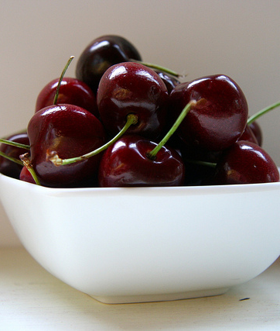
Mixed Methods Data Analysis: everyone gets a bite of the cherry
Benefits of QUANT:
rigorous
systematic
Benefits of QUAL:
exploratory
flexible
Notes:
This marriage of QUANT and QUAL is a mixed methods paradigm. Has the potential to increase the strengths and eliminate the weaknesses of both. Another cherry idiom: the cherry on the top: to add a desirable feature to something that is already good.

Slide 24
References
Baker, P., Hardie, A., & McEnery, T. (2006). A glossary of corpus linguistics (pp. 64-152). Edinburgh: Edinburgh University Press.
Brown, J. D. (2001). Using surveys in language programs. Cambridge University Press.
Lankshear, C., & Knobel, M. (2004). A handbook for teacher research. McGraw-Hill International.

